Slide 1
Microsoft Teams

Slide 2
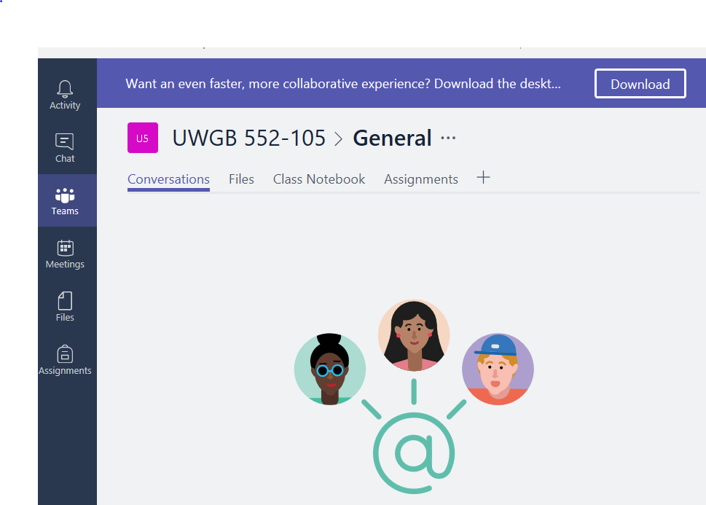
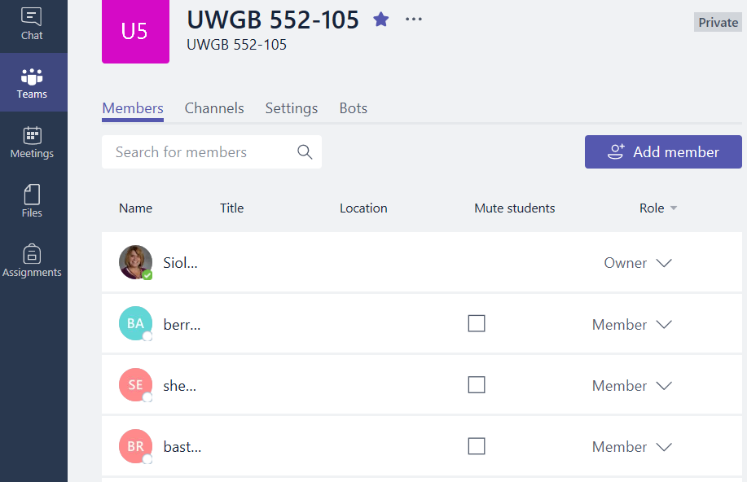
Microsoft Teams
Microsoft Classroom has been replaced by Microsoft Teams
Similar with a few improvements
Your classes should already be loaded
You can add a teacher
If you co-teach or would like SWD teachers to have access to class materials
If you click on the class name
You will see the list of members

Slide 3
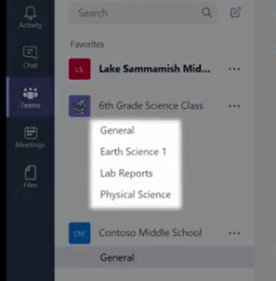
Conversations Tab
@ mention
Use this to direct a message to an individual or the whole class
Can chat as a class, in groups, or with individuals
Can meet in a video chat (coming soon) called Meet Now
Channels
A way to divide into categories like units of study

Slide 4
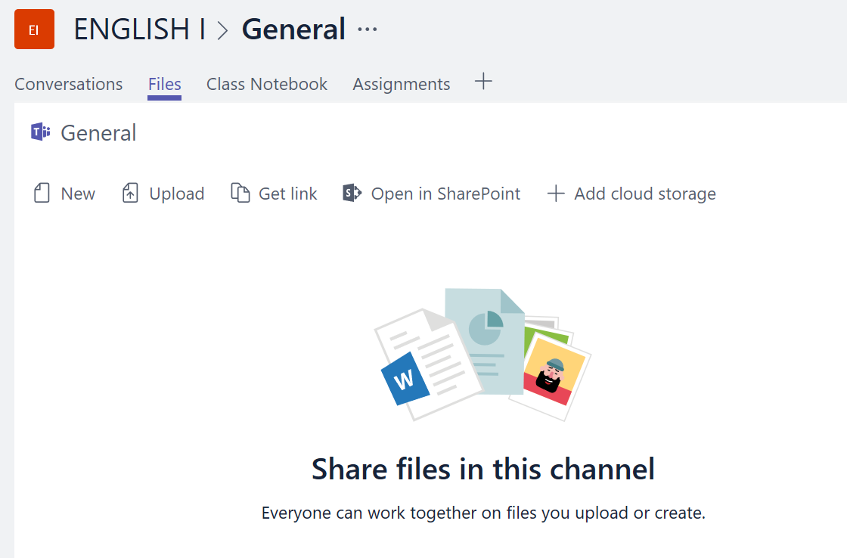
Files Tab
Share all of the files for your classroom, club, or professional learning community in single space

Slide 5
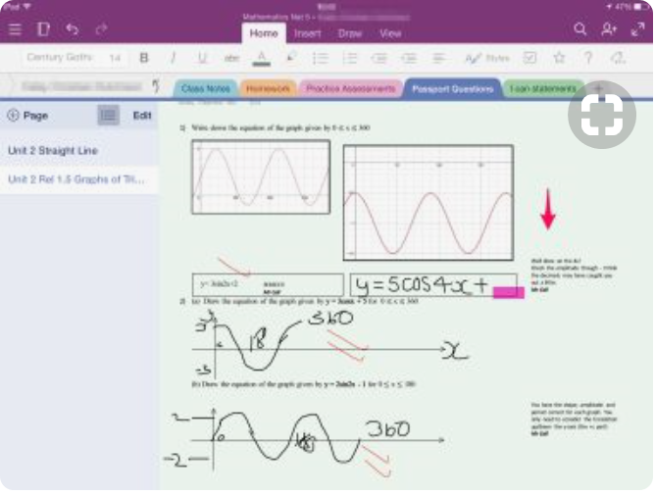
Class Notebook Tab
personal workspace for every student
a content library for handouts
a collaboration space for lessons and creative activities

Slide 6
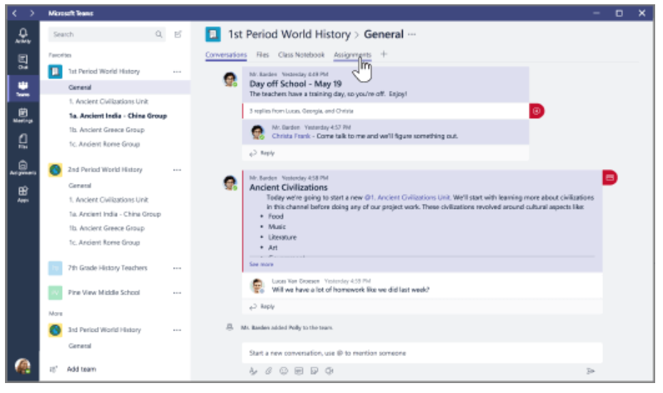
Assignments Tab
Upload assignments under the “general” tab for each class

Slide 7
Create Your Own Tabs
Create your own tabs by clicking on the + symbol
Examples
A science teacher may want a tab for labs
A math teacher may want a tab for example problems
A teacher may make a tab for vocabulary terms for each unit
You can also create a tab for apps that your students use often

Slide 8
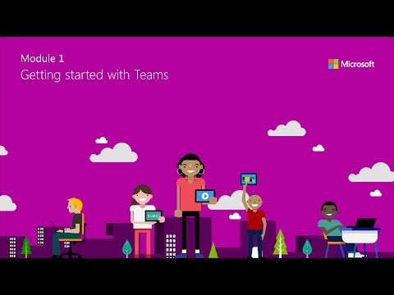
Using Teams in Your Classroom
https://www.youtube.com/watch?v=ZgmIucYKiZM
An introduction

Slide 9
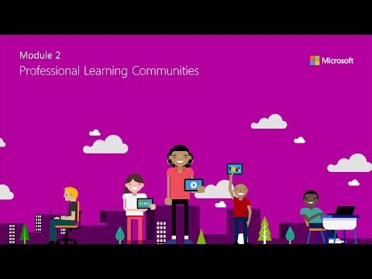
Professional Learning Community
https://www.youtube.com/watch?v=2hzCOXgmYQU
Use Teams to collaborate with staff members, sports teams, or clubs
Share files
Conversations
Book studies
Data share
Share articles
Upload practice schedules
Post plays
Give field trip information

Slide 10
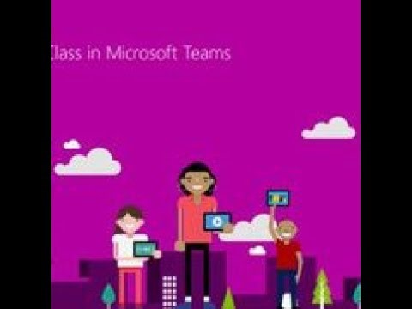
Creating Class Content
https://www.youtube.com/watch?v=pNWhR61eU9Y
This video shows how to upload files and load content

Slide 11
Customize Learning with Teams
https://www.youtube.com/watch?v=104i8tnfA1k
Differentiate Instruction
Add an app to tabs
Introduces planner app

Slide 12
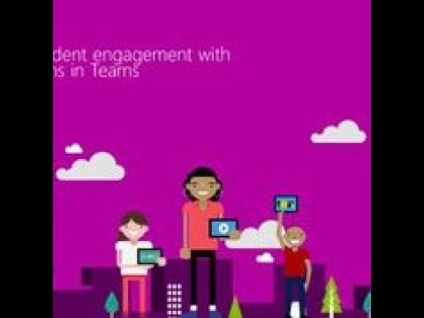
Increase Student Engagement
https://www.youtube.com/watch?v=oHff2W51wZ8
Comments tab
Students can comment on assignments
Teachers can pose questions
Announcements can be posted
Students can have conversations with each other about projects

