Slide 1
How to Research
Guidelines for ethical research

Slide 2
What is a good source?
One source could be from Badger Link or websites ending in .edu or .gov
Other sources can be from reputable web pages, magazines, newspapers, etc.
  Not Wikipedia or other wiki sources or blogs
  Wikis can be changed by the public making them less reputable
  Judge the content of web pages before using

Slide 3
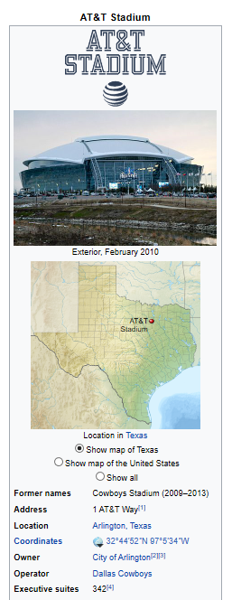

Wikipedia
Wikipedia after the Packers beat Dallas

Slide 4
Take notes from your source
You should take notes from your sources
  If you put your notes in your own words you won’t plagiarize
  Organize your notes so that you know where you gathered your information
  Read source-summarize-restate in paper

Slide 5
Plagiarism
Plagiarism is copying words, sentences, or paragraphs from a published source
Besides putting it in your own words, you also must cite the sources of where you got your information
If you plagiarize, you will get a zero

Slide 6
Creating a works cited page
Use citationmachine.net
Choose MLA style
Choose your source
  Newspaper article
  Magazine article
  Online journal
  Web document
Fill in all of the information in Citation Machine
  Copy and paste it onto your works cited page
  Alphabetize and make them a hanging indent

Slide 7
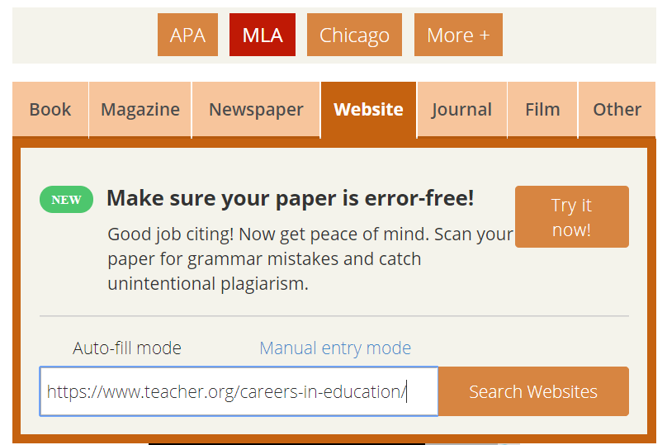
Citation Machine
Copy and paste your URL
Choose search (then “select” and “final step”)

Slide 8
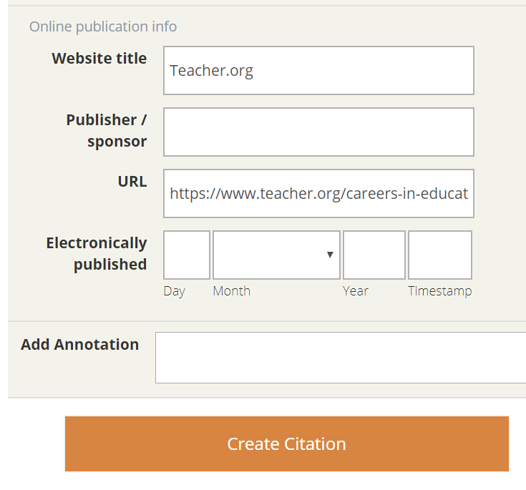

Citation Machine
Double check the information.
  This entry needed to be fixed up.
Choose “Create Citation.”

Slide 9
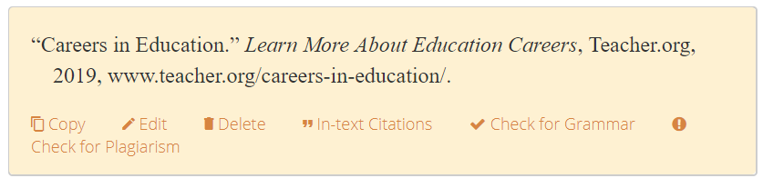

Citation Machine
Copy and paste it onto your works cited
page by choosing the “copy” link.

Slide 10
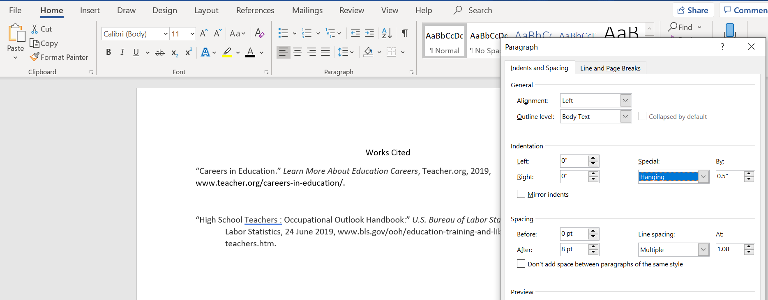
Paste the citation and alphabetize
Paste citation to a Word document. Alphabetize and make it a hanging indent. Conference with your teacher.

